Slide 1
Finding Academic Sources
for your question
Harley Haas
2020

Slide 2
Academic Sources are Important
In both AS-level and A-level Global Perspectives, you will be graded on the quality of your sources and arguments. Having academic sources helps ensure you fulfill the research expectations.

Slide 3
AS-Level rubric

Slide 4
A-Level rubric

Slide 5
Your Question
Once you have your question down you can begin looking for sources

Slide 6
Keep in Mind
There are a lot of sources pertaining to some topics, but you want a source that fits your question and your lens for it
Don’t waste time on a source if is loosely related
Invest in finding good sources so you save time later by not changing your sources
With that in mind, it is okay to change your sources later and not use your initial findings . . . Evolve as a researcher!

Slide 7
Your Lenses
The lenses you pick will determine the type of evidence you include and the sources you use
For example, if you chose an economic lens, then quantitative may be best suited.
Government reports or data from IGOs and NGOs can all offer different benefits for quantitative data.

Slide 8
Criteria for Sources

Slide 9
What is an Academic Source
Once you know what type of sources you want, you need to weed out the bad ones
A good source is
A questionable source is
Recent: published in 2016 or later
* if they are the leading expert in the field, there is some leeway with the date
Has reputable authors
Specific to your question
Sponsored by a reputable organization
Has a clear perspective
Has a references/bibliography
Peer reviewed
You can write a strong validation on it
Has
Biased in their perspective
Only includes some information on your topic . . . It’s a stretch to make the connection
Has easily identifiable fallacies
Used generalities
Has unqualified authors/no authors

Slide 10
Some things to stay away from
Wikipedia/online encyclopedias
While you can use it to see if your topic interests you, do not use for official research
Blogs
Consulting sites
Websites that use a suffix in attempt to mislead
Chat rooms/online forums

Slide 11
Can you reference it properly?
If you can’t fully fill out the reference information for that type of source, you may need to look elsewhere for your information, as the strength of the source and your validation will weaken
If you can fully fill out the reference information, it indicates you’re off to a good start
Even if you can fill it out, you’ll have to do further investigation to make sure the source is reputable

Slide 12
Criteria for “Reputable”
Authors
Publishers
Is the author identifiable?
Never use a source whose author is not cited.
Is the author a professional in their field?
If the author’s name is unfamiliar, is the site linked to an established authority on the subject?
Has this author been cited by professionals or by another respectable website? (see literature search)
Does the website belong to an individual, or is it part of a site maintained by an organization, academic institution, or other group?
Is the type of material appropriate?
Is the site sponsored by a respected organization?
Ex. A UNESCO report is backed by the United Nations
Does the source include a bibliography and/or citations that can be used for comparing or verifying data and other information?
Do many mechanical errors (e.g., grammatical errors, typos, etc.) appear in the text?

Slide 13
Peer reviewed Sources
A source from one of the following publishers is likely to be peer reviewed and of high quality
Wiley-Blackwell
SAGE Publications
McGraw Hill
Nature
Taylor & Francis / Routledge
Harcourt
Ashgate
PLoS
Elsevier
Wolters-Kluwer
Pearson
Cengage
Cambridge University Press
Oxford University Press
Palgrave Macmillan

Slide 14
Finding the Sources

Slide 15
Start with a literature search
Literature search: finding sources and materials you can draw on in your research will help you to decide whether or not you need to do any extra research to generate data for yourself or not
This will help you make your list of sources to investigate
Looking at the bibliographies of the sources you find will ensure you do not miss any information/helpful sources

Slide 16
Keep track of sources
As you find sources, keep track of your research with a folder.
Some research may reference something you want to investigate further.
Keep track of the date you find a source, any quotes you like, the citation, and any notes you have about the source
A research folder for AS might be useful if organized by
Background/general sources
Reason #1 sources
Reason #2 sources
Sources I want to look at further

Slide 17
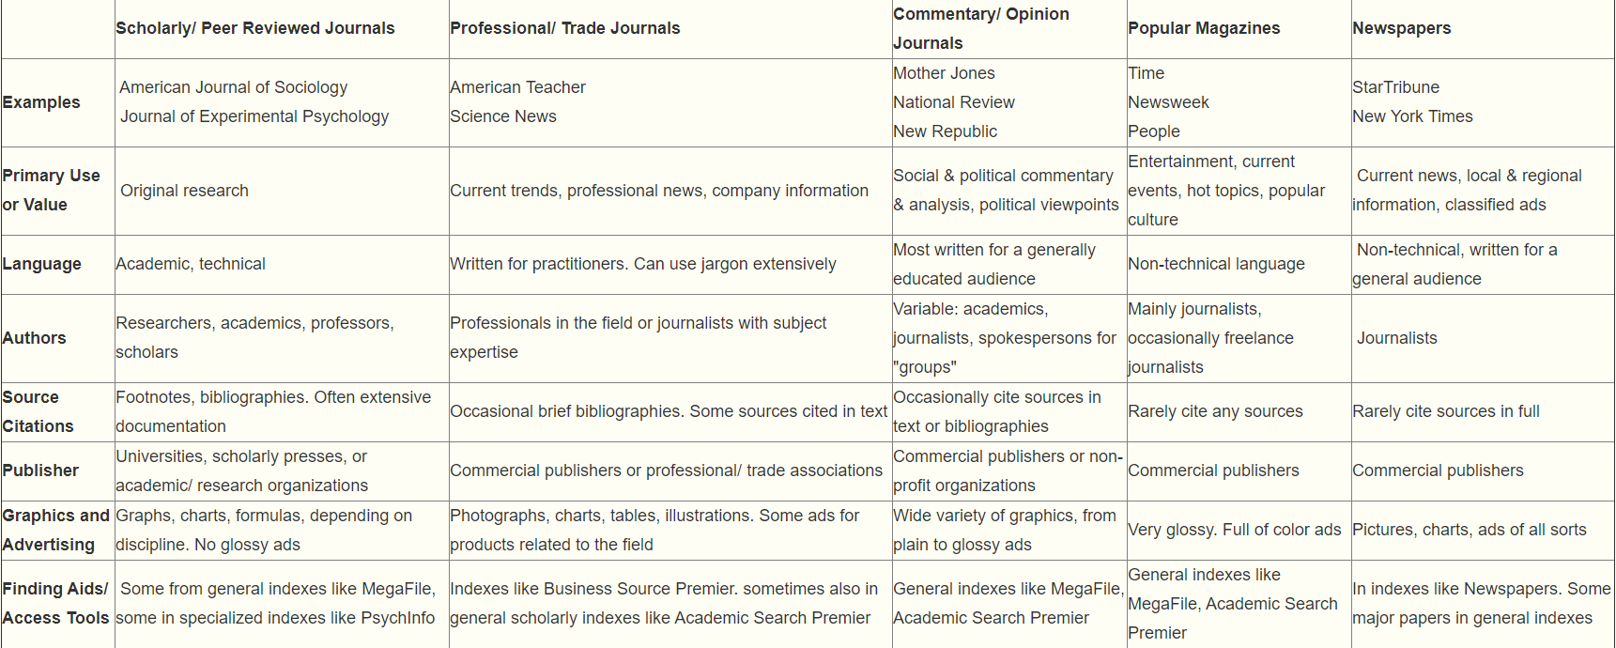
Different types of sources

Slide 18
Academic Search Engines
A lot of the sources you use and research will occur online, so narrow your search with specific engines

Slide 19
Links to search engines
World Cat (largest library catalogue): https://www.worldcat.org/
Web of Science Group: https://wok.mimas.ac.uk/
Cambridge Digital Library: http://cudl.lib.cam.ac.uk/
Google scholar: https://scholar.google.com/
Microsoft Academic: https://academic.microsoft.com/home
Bielefeld Academic Search Engine: https://www.base-search.net/
CORE (open access research papers): https://core.ac.uk/
US federal Science agencies: https://www.science.gov/
Semantic scholar (peer-reviewed): https://www.semanticscholar.org/

Slide 20
The Library
Get a library card or see if you have a friend in college willing to lend their ID
The library has a slew of free sources, both physical and online
Reading books is a good way to gain background information on your paper
You can use the online library catalog to have books brought to a location near you
Keep an eye out for the publishing date; some books may have been added many years ago
If you can’t find a hard copy version of a book, try the online resource
Just because it is in a book, doesn’t mean the information in credible for a research paper
For example, a blogger can get published

Slide 21
Online Library Sources
Sarasota Library also gives access to a slew of digital resources for library card holders
A full list of digital resources can be found at
https://www.scgov.net/government/libraries/library-resources/digital-library
* the history section has some great academic source

Slide 22
Good Luck!
Have fun researching and make sure to take advantage of all the different research methods you have available to you as a student.

